Slide 1
Visual Odometry and Visual SLAM in Mobile Robotics
Chitradevi Maruthavanan Fall 2023

Slide 2
Abstract
To support new researchers in the field of robotics and autonomous systems, particularly those interested in robot localization and mapping.
It covers a range of techniques, from basic methods like wheel odometry and dead reckoning to advanced Visual Odometry (VO) and Simultaneous Localization and Mapping (SLAM).
VO is discussed in both monocular and stereo vision systems using feature matching/tracking and optical flow techniques. Common SLAM methods such as Extended Kalman Filter SLAM (EKF-SLAM), Particle Filter, and the latest RGB-D SLAM are compared.
The paper also provide the insights into the foundational techniques for these methods, including feature extraction (e.g., SIFT, SURF, FAST), feature matching, outlier removal, and data association techniques.
Notes:
Autonomous navigation requires accurate robot localization and mapping.
Localization is fundamental for robots to determine their position in the environment.
Review of state-of-the-art techniques in mobile robot localization and mapping.

Slide 3
Introduction
The growing importance of mobile robotics and autonomous systems, which have made substantial progress over the past few decades.Mobile robots can now perform complex tasks autonomously, reducing the need for human input.
The applications for mobile robotics, including military, medical, space, entertainment, and domestic appliances. It emphasizes the need for robots to navigate complex and dynamic environments without human intervention.
Simplest form of localization is using wheel odometry methods to measure amount of rotation of robot’s wheels

Slide 4
Wheel rotation measurements are used along with the robot’s motion model to find the robot’s current location with respect to a global reference coordinate system
But measurement errors are accumulated over time and cause the estimated robot pose to drift from its actual location
There are a number of error sources in wheel odometry methods, the most significant being wheel slippage in uneven terrain or slippery floors
To overcome those limitations, other localization strategies are using inertial measurement units (IMUs), GPS,LASER odometry and most recently Visual Odometry and Simultaneous Localization and Mapping (SLAM) methods have been proposed

Slide 5
Visual Odometry
VO is defined as the process of estimating the robot’s motion (translation and rotation with respect to a reference frame) by observing a sequence of images of its environment.
VO is a technique known as Structure From Motion (SFM) that tackles the problem of 3D reconstruction of both the structure of the environment and camera poses from sequentially ordered or unordered image sets
Although VO does not solve the drift problem, researchers have shown that VO methods perform significantly better than wheel odometry techniques while the cost of cameras is much lower compared to accurate IMUs and LASER scanners
VO is most famous for its application in the ongoing robotic space mission on Mars that started in 2003 involving two rovers that were sent to explore the geology and surface of the planet.

Slide 6
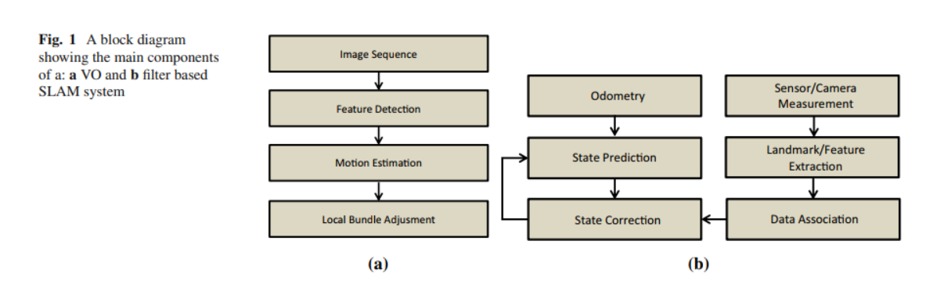
VO and SLAM

Slide 7
Visual SLAM
SLAM is a process in which a robot is required to localize itself in an unknown environment and build a map of this environment at the same time without any prior information with the aid of external sensors
The main difference between VO and SLAM is that VO mainly focuses on local consistency and aims to incrementally estimate the path of the camera/robot pose after pose. Whereas SLAM aims to obtain a globally consistent estimate of the camera/robot trajectory and map
Recently there has been an increased interest in visual based SLAM also known as VSLAM because of the rich visual information available from low-cost video sensors compared to LASER scanners.

Slide 8
However, the trade off for Visual SLAM is a higher computational cost and the requirement for more sophisticated algorithms for processing the images and extracting the necessary information.
Due to recent advances in CPU and GPU technologies, the real time implementation of the required complex algorithms are no longer a big problem
Most Recently, there has been an increasing interest in dense 3D reconstruction of the environment as opposed to the sparse 2D and 3D SLAM problems
Henry et al. were the first to implement an RGB-D mapping approach that employed an RGB-D camera (i.e. Microsoft Kinect). They used this information to obtain a dense 3D reconstructed environment.

Slide 9

Localization – Visual Odometry
Motion Estimation
In general, there are three commonly used VO motion estimation techniques called: 3D to 3D, 3D to 2D and 2D to 2D methods. Figure 2 illustrates an example of the VO problem. The motion estimation techniques are outlined here.
3D to 3D Motion Estimation In this approach, the motion is estimated by triangulating 3D feature points observed in a sequence of images. The transformation between the camera frames is then estimated by minimizing the 3D Euclidean distance between the corresponding 3D points as shown below.
where,
T is the estimated transformation between two consecutive frames
X is the 3D feature point observed by the current frame Fk
X´ is the corresponding 3D feature point in the previous frame Fk-1
i is the minimum number of feature pairs required to constrain the transformation.
The minimum number of required points depends on the type of modeling used. Although using more points means more computation, better accuracy is achieved by including more points than the minimum number required

Slide 10

3D to 2D Motion Estimation This method is similar to the previous approach but here we have the 2D re-projection error. This has to be minimized to find the required transformation. The cost function for this method is as follows:
where,
T is the estimated transformation between two consecutive frames
z is the observed feature point in the current frame Fk
f (T, X´i) is the re-projection function of its corresponding 3D feature point in the previous frame Fk-1 after applying a transformation
i is the number of feature pairs.
Again, the minimum number of points required varies based on the number of constraints in the system.

Slide 11
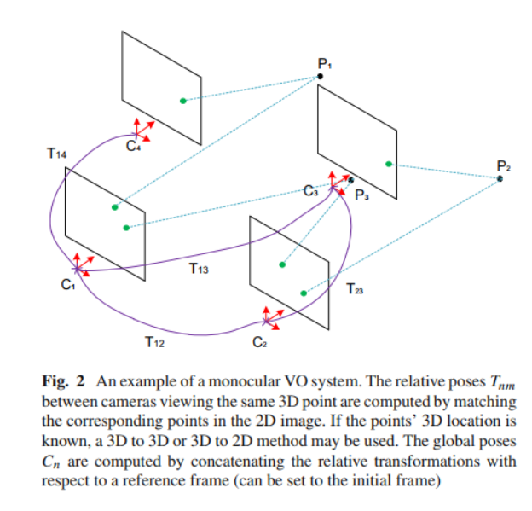
Monocular VO System

Slide 12
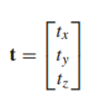
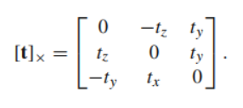
2D to 2D Motion Estimation
The 3D to 3D and 3D to 2D approaches are only possible when 3D data are available. This is not always the case, for instance, estimating the relative transformation between the first two calibrated monocular frames where points have not been triangulated yet.
In this case, the epipolar geometry is exploited to estimate this transformation. An example of the epipolar geometry is illustrated in next slide. The figure shows two cameras, separated by a rotation and a translation, viewing the same 3D point. Each camera captures a 2D image of the 3D world.
This conversion from 3D to 2D is referred to as a perspective
The epipolar constraint used in this approach is written as:
q′⊤Eq = 0 where q and q′ are the corresponding homogeneous image points in two consecutive frames and E is the essential matrix
E = [t]×R (4)
where R is the rotation matrix, t is the translation matrix and [t]× is the skew symmetric matrix

Slide 13
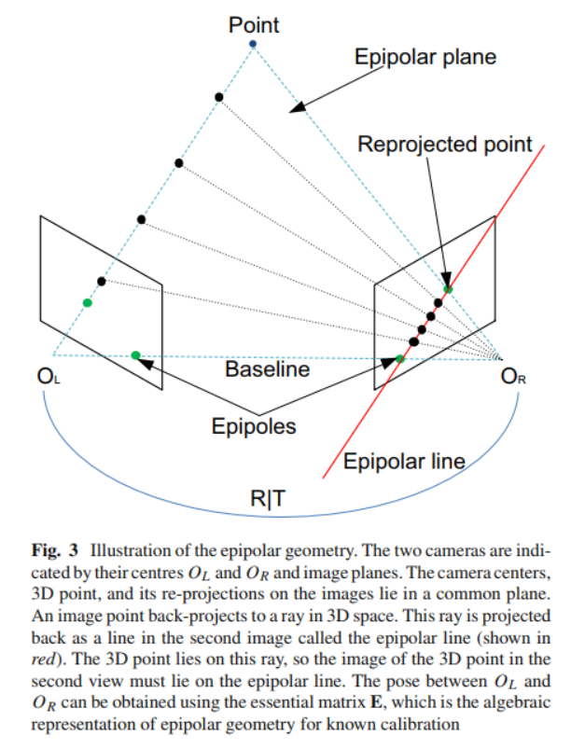
2D to 2D Motion Estimation

Slide 14
Stereo Vision vs Monocular Vision
Stereo Visual Odometry
In stereo vision, 3D information is reconstructed by triangulation in a single time-step by simultaneously observing the features in the left and right images that are spatially separated by a known baseline distance.
In Stereo VO, motion is estimated by observing features in two successive frames (in both right and left images).
Monocular Visual Odometry
For the reconstruction of feature points in 3D via triangulation, they are required to be observed in successive frames (time separated frames).
In monocular VO, feature points need to be observed in at least three different frames (observe features in the first frame, re-observed and triangulate into 3D points in the second frame, and calculate the transformation in the third frame).

Slide 15
Mapping
In most real-world robotics applications, maps of the environment in which the mobile robot is required to localize and navigate are not available. In general, mapping the environment is considered to be a challenging task. The most commonly used mapping representations are as follows
Metric Maps
In metric maps, the environment is represented in terms of geometric relations between the objects and a fixed reference frame. The most common forms of metric maps are:
Feature Maps
Feature maps represent the environment in a form of sparse geometric shapes such as points and straight lines.
Localization is performed by observing and detecting features and comparing those with the previously stored features.

Slide 16
Occupancy Grids
Occupancy Grid maps are represented by an array of cells in which each cell (or pixel in an image) represents a region of the environment.
Unlike feature maps which are concerned about the geometric shape or type of the objects, occupancy grids are only concerned about the occupancy probability of each cell.
This probability value ranges between 0 (not occupied) and 1 (occupied).
Topological Maps
In contrast to metric maps which are concerned about the geometric relations between places or landmarks, topological maps are only concerned about adjacency information between objects and avoid metric information as far as possible.
Topological maps are usually represented by a graph in which nodes define places or landmarks and contain distinctive information about them and connecting arcs that indicate adjacency information between the connected nodes.
Topological maps are particularly useful in representing a large environment
Hybrid Maps (Metric + Topological)
In general, metric maps result in more accurate localization, whereas topological maps results in an abstract representation of the environment which is more useful for path planning methods.
Combination of both these features lead to a improved navigation.

Slide 17
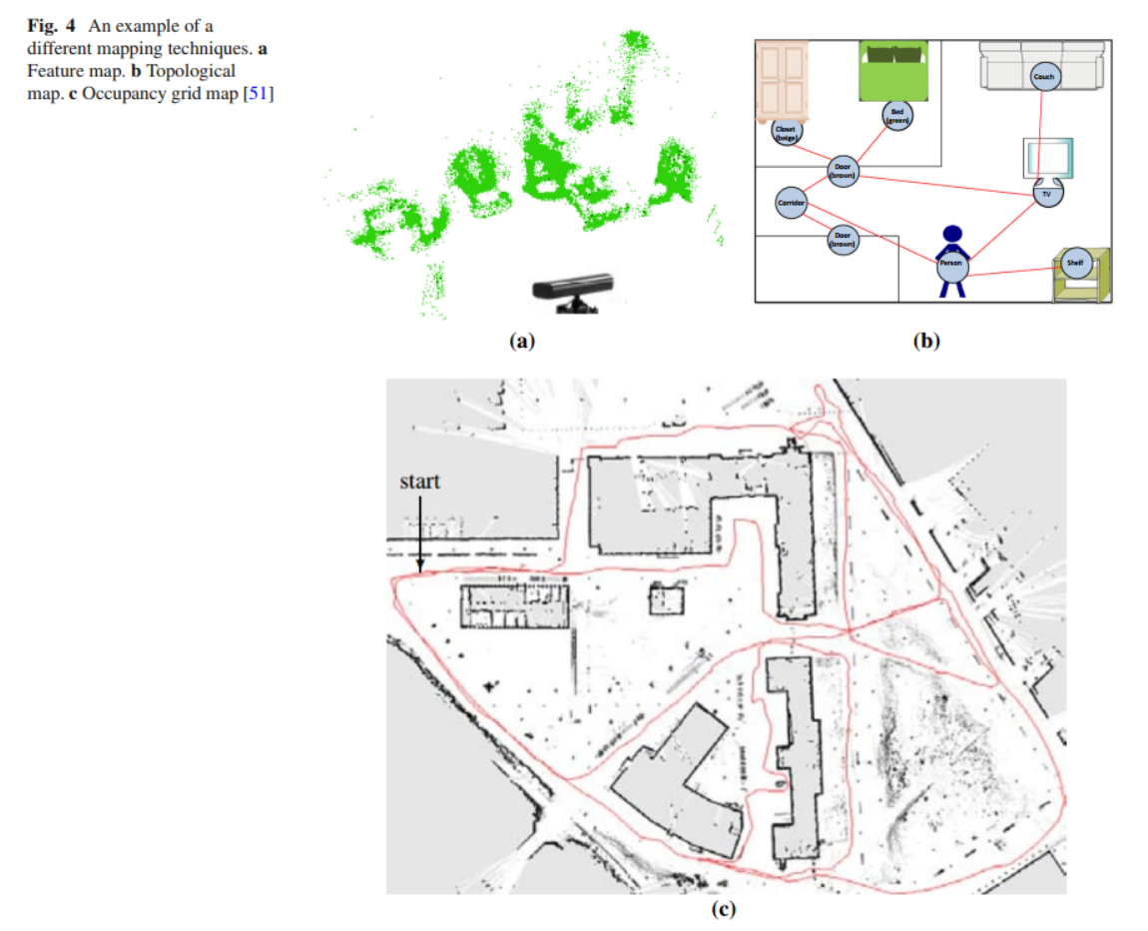
Mapping

Slide 18
SLAM
SLAM is an attempt to solve both of those problems (localization and mapping) at the same time. SLAM approaches have been categorized into filtering approaches (such as EKF-SLAM and particle filter based SLAM) and smoothing approaches (such as GraphSLAM, RGB-D SLAM, Smoothing and Mapping).
The EKF-SLAM is divided into two main stages: prediction and correction
In the prediction step, the future position of the robot is estimated (predicted) based on the robot’s current position and the control input that is applied to change the robot’s position from time step k to k +1.
The general motion model equation can be formulated as:
Xk+1 = f (Xk, Uk) + Wk
where Xk+1 is an estimate of the robot’s future position,
f (Xk, Uk) is a function of the current estimate of the robot’s position
Uk the control input that is applied to change the robot’s position from time step k to k + 1
Wk is the process uncertainty that is assumed to be uncorrelated zero mean Gaussian noise with covariance Q.
The general measurement (observation) model can be formulated as:
z = h(Xk) + Vk
where z is the noisy measurement, h(Xk) is the observation function and Vk is the measurement noise

Slide 19
Fundamental Components in V-SLAM and VO
Camera Modeling and Calibration - Perspective Projection
The basic and most common model is the perspective camera model.
Perspective is the property that objects that are far away appear smaller than closer objects, which is the case with human vision and most real world cameras.
The most common model for perspective projection is the pinhole camera model which assumes that the image is formed by the intersecting light rays from the objects passing through the center of the projection with the image plane.

Slide 20
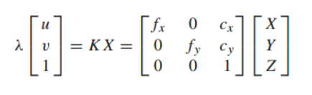
Perspective Projection
The pinhole perspective projection equation can be written as:
where u and v are the 2D image coordinates of a 3D point with coordinates X, Y and Z
The 3D point is projected onto the image plane.
λ is a depth factor
K is the intrinsic calibration matrix and contains the intrinsic parameters
Intrinsic parameters are as below:
fx and fy are the focal lengths in the x and y directions
cx and cy are the 2D coordinates of the projection center

Slide 21
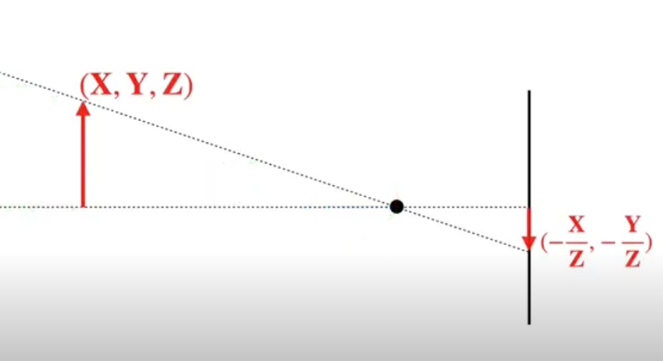
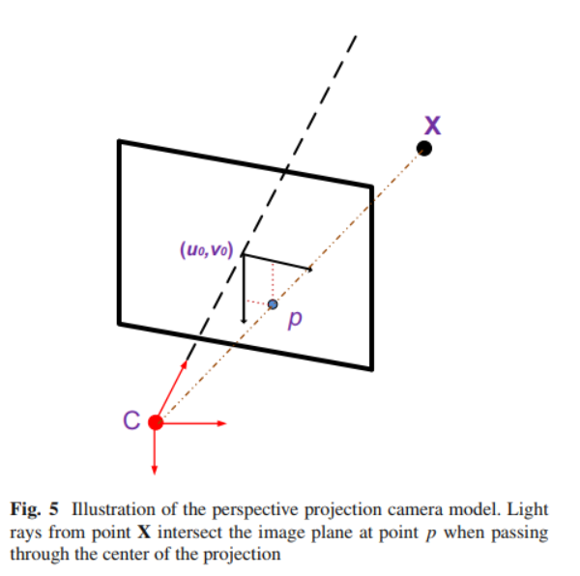
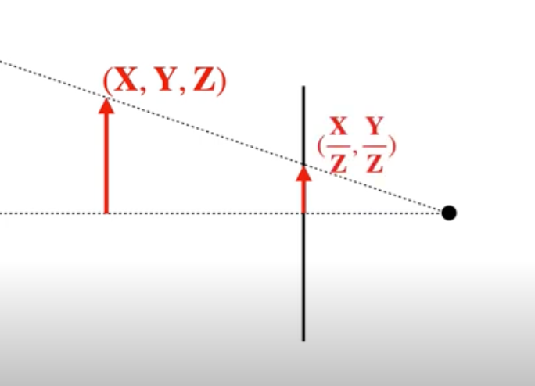
Perspective Projection
Pinhole Camera
Pinhole Camera(Perspective Projection)

Slide 22
Intrinsic Camera Calibration
Camera calibration is the process of finding the quantities internal to the camera (intrinsic parameters) that affect the imaging process such as the image center, focal length and lens distortion parameters.
Precise camera calibration is required due to having camera production errors and lower quality lenses.
The most popular method uses a planar checkerboard pattern with known 3D geometry.
The user is required to take several images of the checkerboard at varying poses and covering the field of view of the camera as much as possible.
The parameters are estimated by solving a LS minimization problem

Slide 23
Feature Extraction and Matching
Vision sensors have attracted a lot of interest from researchers over the years as they provide images that are rich in information. In most cases, raw images need to be processed in order to extract the useful information.
Features that are of interest range from simple point features such as corners to more elaborate features such as edges and blobs and even complex objects such as doorways and windows.
Feature tracking is the process of finding the correspondences between such features in adjacent frames and is useful when small variations in motions occur between two frames.
Conversely, feature matching is the process of individually extracting features and matching them over multiple frames.

Slide 24
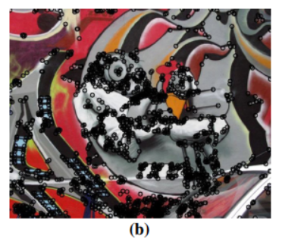
Feature Extraction - Harris Corner Detector Method
As per this method a uniform region is defined to have no change in image intensities between adjacent regions in all directions
In case of edges and corners there are significant variation between adjacent regions in all directions

Slide 25
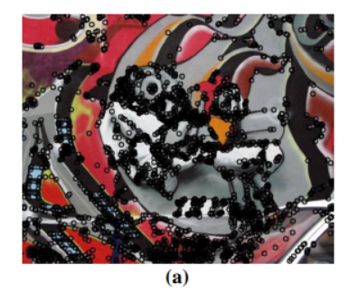
Feature Extraction - FAST Corners Method
Features From Accelerated Segment Test (FAST) is a corner detector in which a circle with a circumference of 16 pixels is placed around the center pixel.
The brightness value of each pixel in this circle is compared to the center pixel. A region is defined as uniform, an edge or a corner based on the percentage of neighboring pixels with similar intensities to the center pixel.
FAST is known to be one of the most computationally efficient feature extraction methods

Slide 26
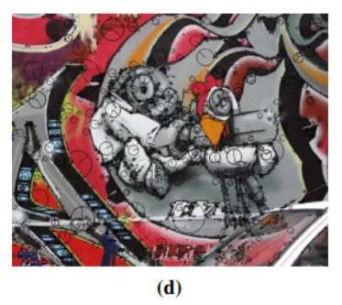
Feature Extraction - SIFT Method
Scale Invariant Feature Transform (SIFT) is recognized by many as one of the most robust feature extraction techniques currently available.
SIFT is a blob detector in which a blob can be defined as an image pattern that differs from its immediate neighborhood in terms of intensity, color and texture.
The main downside of this method is that it is computationally expensive.

Slide 27
RGB-D SLAM
RGB-D SLAM (or RGB-D mapping) is a V-SLAM method that uses RGB-D sensors for localization and mapping. RGBD sensors are ones that provide depth information in addition to the color information.
The more recent RGB-D cameras such as the Kinect are based on the structured light approach which capture RGB color images and provide pixel depth information.
The aim of RGB-D SLAM is to obtain a dense 3D representation of the environment while keeping track of the camera pose at the same time.

Slide 28
Feature Extraction, Matching and Refinement
The first step is to extract and match features across sequential images.
In feature extraction points of interest such as edges and corners are detected in the images.
The depth information provided by the RGB-D camera are then used to obtain these points in 3D (point clouds).
Matching extracted features between sequential frames is then performed using an appropriate DA (Data Association) technique
The ICP (Iterative Closest Point) is a common technique in computer vision for aligning 3D points obtained by different frames. ICP iteratively aligns the closest points (found using a fast nearest neighbor approach) in two clouds of points until convergence.

Slide 29
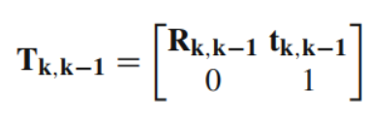

Global Transformation
Global estimate with respect to a reference frame, all the transformations up to the current time need to be concatenated. Let us denote the transformation between two frames as:
where Rk,k-1 is the rotation matrix and tk,k-1 is the translation vector between frames taken at timesteps k and k - 1 respectively and where k = 1 . . . n.
The global estimate Gn can be calculated using the following formula:
where Gn-1 is the previous global transformation with respect to an initial reference frame G0 at k = 0
Tn,n-1 is the transformation between the current frame and the previous frame.

Slide 30
Global Optimization
Pose graph optimization
This is a global optimization method used in SLAM and VO problems that are represented by a graph model.
The graph model consists of nodes that correspond to the camera poses and edges
The pose graph model allows the formation of constraints between non-adjacent poses by observing the same features from different locations.
The goal of this optimization is to find the arrangement of poses that best satisfies those constraints.
Generally, this is a non-linear LS optimization problem which can be described as:

Slide 31
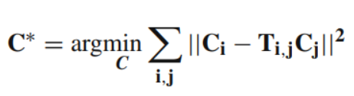
Pose Graph Optimization
where C∗ = C∗ 1 . . . C∗ n is a vector containing all the optimized camera poses (x, y and z values).
There are a number of approaches for solving the above optimization problem such as Graph SLAM, TORO (Tree Based Network Optimizer), HOG-MAN (Hierarchical Optimizations on Manifolds for 2D and 3D Mapping) etc

Slide 32
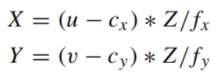
Loop Closure - Map Representation
The global optimization and loop closure steps produces a globally consistent trajectory (i.e. each node/frame is associated with an optimized global pose).
In order to build the map, the points are projected to 3D using the following equations:
where (u, v) is the image coordinate of an extracted visual feature in 2D
(X, Y, Z) is its projected 3D coordinate in the camera optical frame.
Z is obtained from the depth image which is provided by the RGB-D sensor.
fx and fy are the focal lengths in the horizontal and vertical axis respectively
(cx, cy) is the 2D coordinate of the camera optical center.
After applying this projection, 3D points are then transformed to a common reference frame using the optimized trajectory

Slide 33
Conclusion
In this paper, a extensive theoretical review of solutions for the VO and visual SLAM (V-SLAM) problems is presented.
The SLAM problem was discussed and the basic framework for solving this problem was presented.
The fundamental techniques used in both VO and V-SLAM such as feature extraction and DA (Data Association) methods were discussed.
The recently popularized RGBD SLAM approach for solving the V-SLAM problem was also discussed.
The RGB-D SLAM approach consists of combining visual odometry methods for finding the relative transformation between frames, and SLAM methods for global optimization and loop closure.

Slide 34
Thank you

